Slide 1
Markers Product Range
Luxor International Pvt. Ltd., India

Slide 2
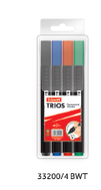
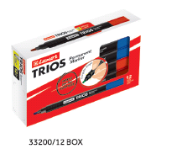
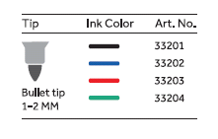
TRIOS PERMANENT MARKER
Product Code | Packing | Inner Carton Qty | Master Carton Qty
33200/4 BWT | Wallet of 4 | 12 WT | 144 WT
333200/12 Box | Box of 12 | Pcs | 1152 Pcs

Slide 3
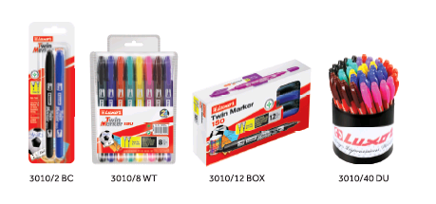
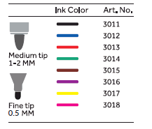
TWIN MARKER 150
Product Code | Packing | Inner Carton Qty | Master Carton Qty
3010/2 BC | Blister of 2 | 12 Cards | 144 Cards
3010/8 WT | Wallet of 8 | 12 WT | 144 WT
3010/12 Box | Box of 12 | Pcs | 1152 Pcs
3010/40 DU | Display Unit of 40 | - | 24 DU

Slide 4
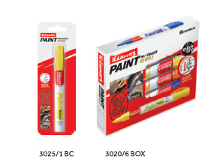
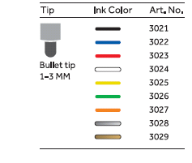
PAINT MARKER 880
Product Code | Packing | Inner Carton Qty | Master Carton Qty
3025/1 BC | Blister of 1 | 12 Cards | 144 Cards
3020/6 Box | Box of 6 | - | 432 Pcs

Slide 5
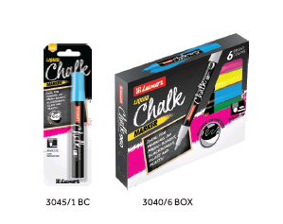
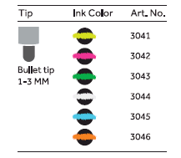
LIQUID CHALK MARKER
Product Code | Packing | Inner Carton Qty | Master Carton Qty
3045/1 BC | Blister of 1 | 12 Cards | 144 Cards
3040/6 Box | Box of 6 | - | 432 Pcs

Slide 6
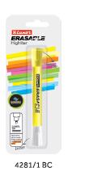
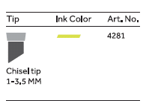
ERASABLE HIGHLITER
Product Code | Packing | Inner Carton Qty | Master Carton Qty
4281/1 BC | Blister of 1 | 12 Cards | 144 Cards

Slide 7
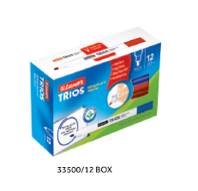
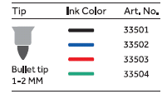
TRIOS WHITEBOARD MARKER
Product Code | Packing | Inner Carton Qty | Master Carton Qty
33500/12 Box | Box of 12 | 144 Pcs | 1152 Pcs

Slide 8
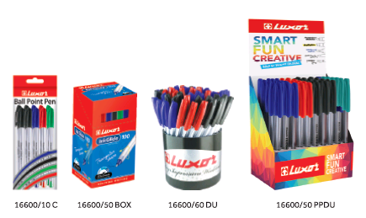
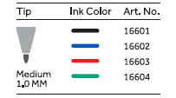
INK GLIDE 100 BALL PEN
Product Code | Packing | Inner Carton Qty | Master Carton Qty
16600/10 C | Cello Pack of 10 | 12 Cello | 144 Cello
16600/50 Box | Box of 50 | - | 1200 Pcs
16600/60 DU | Display Unit of 60 | - | 24 DU
16600/50 PPDU | PPDU of 50 | - | 8 PPDU

Slide 9
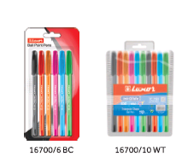
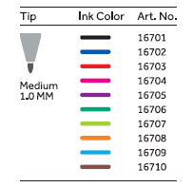
INK GLIDE 100 ICY BALL PEN
Product Code | Packing | Inner Carton Qty | Master Carton Qty
16700/6 BC | Blister of 6 | 12 Cards | 144 Cards
16700/10 WT | Wallet of 10 | 12 WTs | 144 WTs
16700/50 Box | Box of 50 | - | 1200 Pcs
16700/60 DU | Display Unit of 60 | - | 24 DU

Slide 10
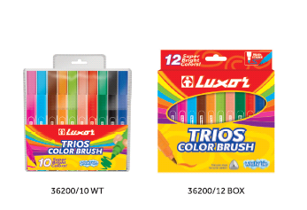
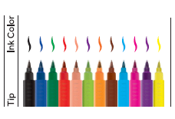
TRIOS COLOR BRUSH
Product Code | Packing | Inner Carton Qty | Master Carton Qty
36200/10 WT | Wallet of 10 | - | 72 WTs
36200/12 Box | Box of 12 | - | 72 Sets

Slide 11
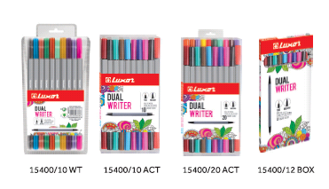
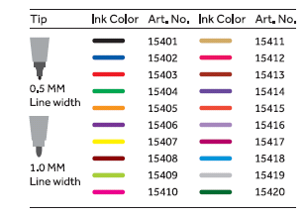
DUAL WRITER
Product Code | Packing | Inner Carton Qty | Master Carton Qty
15400/10 WT | Wallet of 10 | 10 WTs | 80 WTs
15400/10 ACT | ACT of 10 | - | 80 ACT
15400/20 ACT | ACT of 20 | - | 40 ACT
15400/12 Box | Box of 12 | 144 Pcs | 1152 Pcs

Slide 12
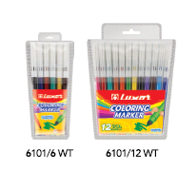
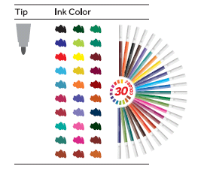
COLORING PEN
Product Code | Packing | Inner Carton Qty | Master Carton Qty
6101/6 WT | Wallet of 6 | 24 WTs | 288 WTs
6101/12 WT | Wallet of 12 | 12 WTs | 144 WTs

Slide 13
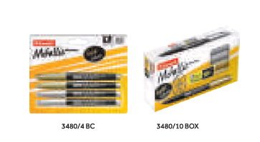
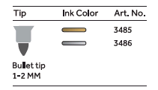
METALLIC MARKER
Product Code | Packing | Inner Carton Qty | Master Carton Qty
3480/10 BOX | Box of 10 | 100 Pcs | 800 Pcs
3480/4 BC | Blister of 4 | 12 Cards | 144 Cards

Slide 14
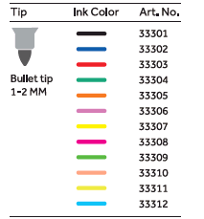
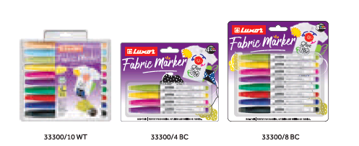
FABRIC MARKER
Product Code | Packing | Inner Carton Qty | Master Carton Qty
33300/10 WT | Wallet of 10 | 12 WTs | 144 WTs
33300/4 BC | Blister of 4 | 12 Cards | 144 Cards
33300/8 BC | Blister of 8 | 12 Cards | 72 Cards

Slide 15
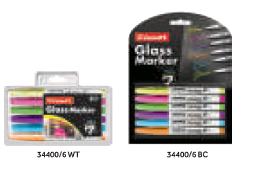
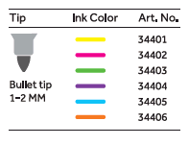
GLASS MARKER
Product Code | Packing | Inner Carton Qty | Master Carton Qty
34400/6 WT | Wallet of 6 | 144 Pcs | 576 Pcs
34400/6 BC | Blister of 6 | 12 Cards | 72 Cards

Slide 16
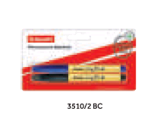
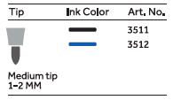
LAUNDRY MARKER
Product Code | Packing | Inner Carton Qty | Master Carton Qty
3510/ 2 BC | Blister of 2 | 12 Cards | 144 Cards

Slide 17
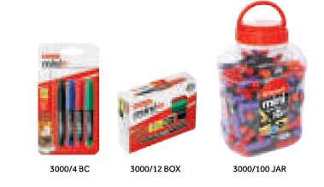
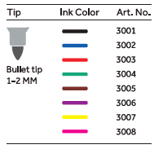
MINI PERMANENT MARKER
Product Code | Packing | Inner Carton Qty | Master Carton Qty
3000 /12 BOX | Box of 12 | 144 Pcs | 1152 Pcs
3000/4 BC | Blister of 4 | 12 Cards | 144 Cards
3000/100 JAR | Jar of 100 | - | 6 Jar

Slide 18
LAUNDRY MARKER
Product Code | Packing | Inner Carton Qty | Master Carton Qty
3000 /12 BOX | Box of 12 | 144 Pcs | 1152 Pcs
3000/4 BC | Blister of 4 | 12 Cards | 144 Cards
3000/100 JAR | Jar of 100 | - | 6 Jar

Slide 19
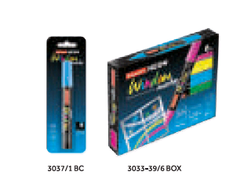
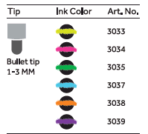
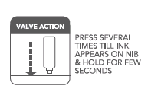
WINDOW MARKER
Product Code | Packing | Inner Carton Qty | Master Carton Qty
3033-39/6 BOX | Box of 6 | - | 432 Pcs
3037/1 BC | Blister of 1 | 12 Cards | 144 Cards

Slide 20
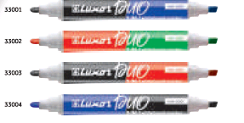
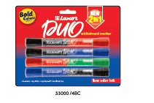
DUO 2-IN-1 WHITE BOARD MARKER
Product Code | Packing | Inner Carton Qty | Master Carton Qty
33000/4 BC | Blister of 4 | 12 Cards | 144 Cards

Slide 21
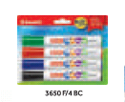
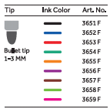
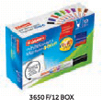
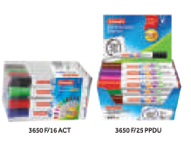
WHITE BOARD MARKER 450 C
Product Code | Packing | Inner Carton Qty | Master Carton Qty
3650 F | Box of 12 | 144 Pcs | 576 Pcs
3650 F/4 BC | Blister of 4 | 12 Cards | 144 Cards
3650 F/16 ACT | Acetate of 16 | - | 3 ACT
3650 F/25PPDU | PPDU of 25 | - | 8 PPDU

Slide 22
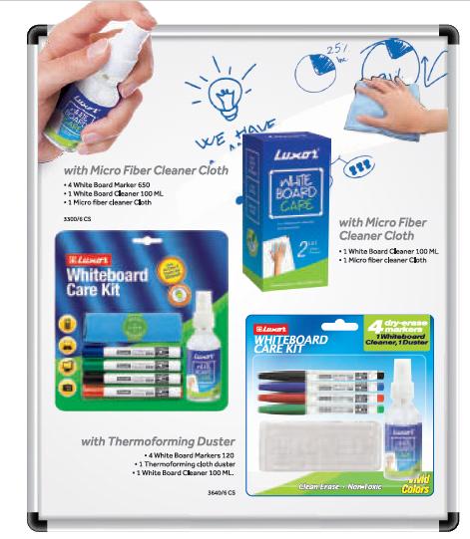
WHITEBOARD CARE KIT
Product Code | Packing | Inner Carton Qty | Master Carton Qty
Whiteboard Care | Box of 2 | TBD | TBD
3300/6 CS | Board of 6 | 12 Sets | 48 Sets

Slide 23
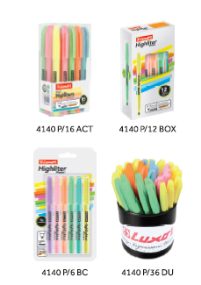
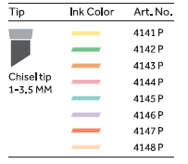
HIGHLITER PASTEL
Product Code | Packing | Inner Carton Qty | Master Carton Qty
4140P | Box of 12 | 144 Pcs | 1152 Pcs
4140P/6 BC | Blister of 6 | 12 Cards | 144 Cards
4140P/36 ACT | Acetate of 16 | - | 3 ACT
4140P/36 DU | DU of 36 | - | 24 DU

Slide 24
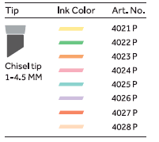
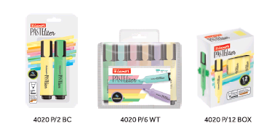
PASTELITER
Product Code | Packing | Inner Carton Qty | Master Carton Qty
4020P | Box of 12 | 144 Pcs | 576 Pcs
4020P/2 BC | Blister of 2 | 12 Cards | 144 Cards
4020P/6 WT | Wallet of 6 | 12 WTs | 144 WTs

Slide 25
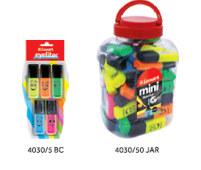
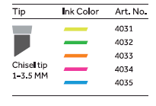
EYELITER FLUORESCENT
Product Code | Packing | Inner Carton Qty | Master Carton Qty
4030/5 BC | Blister of 5 | 12 Cards | 144 Cards
4050/50 JAR | JAR of 50 | - | 6 JAR

Slide 26
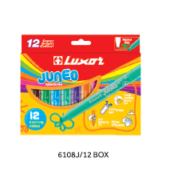
JUNEO MARKER PEN
Product Code | Packing | Inner Carton Qty | Master Carton Qty
6108J/12 BOX | Box of 12 | - | 72 Sets

Slide 27
MAGIC MARKER
Product Code | Packing | Inner Carton Qty | Master Carton Qty
6104/8 BOX | Box of 8 | - | 144 Sets
6104/12 SRP | SRP of 12 sets | - | 4 SRP

Slide 28
SCENTED MARKER
Product Code | Packing | Inner Carton Qty | Master Carton Qty
3440/5 BOX | Box of 5 | - | 18 Sets
3440/10 BOX | Box of 10 | - | 24 Sets

